Slide 1
ICCV 2017 Adversarial Examples for Semantic Segmentation and Object Detection
Cihang Xie, Jianyu Wang, Zhishuai Zhang,
Yuyin Zhou, Lingxi Xie, Alan Yuille
Department of Computer Science
The Johns Hopkins University

Slide 2
Outline
Introduction
Adversarial Examples in Computer Vision
Dense Adversarial Generation (DAG)
Experiments: White-box Attack
Experiments: Black-box Attack
Fancy Examples
Conclusions and Future Work

Slide 3
Outline
Introduction
Adversarial Examples in Computer Vision
Dense Adversarial Generation (DAG)
Experiments: White-box Attack
Experiments: Black-box Attack
Fancy Examples
Conclusions and Future Work

Slide 4
Introduction
Deep Learning
The state-of-the-art machine learning theory
Using a cascade of many layers of non-linear neurons for feature extraction and transformation
Learning multiple levels of feature representation
Higher-level features are derived from lower-level features to form a hierarchical architecture
Multiple levels of representation correspond to different levels of abstraction

Slide 5
Introduction (cont.)
The Convolutional Neural Networks
A fundamental machine learning tool
Good performance in a wide range of problems in computer vision as well as other research areas
Evolutions in many real-world applications
Theory: a multi-layer, hierarchical network often has a larger capacity, also requires a larger amount of data to get trained

Slide 6
Outline
Introduction
Adversarial Examples in Computer Vision
Dense Adversarial Generation (DAG)
Experiments: White-box Attack
Experiments: Black-box Attack
Fancy Examples
Conclusions and Future Work

Slide 7
Adversarial Examples: Introduction
What is an adversarial example (in this work)?
An image, with a small perturbation added, which can still be recognized by humans, but not by the computers (deep neural networks)
Type 1: an image with clear visual contents is recognized incorrectly
Type 2: an image with no visual contents is recognized as a non-understandable class

Slide 8
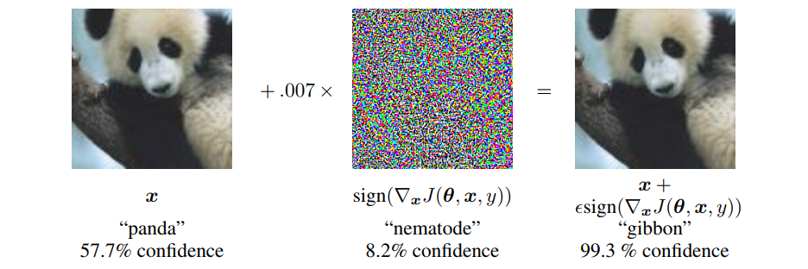
Adversarial Examples: Type 1
Slightly perturbed natural images that are completely wrongly recognized
Example from [Goodfellow, ICLR'15]

Slide 9
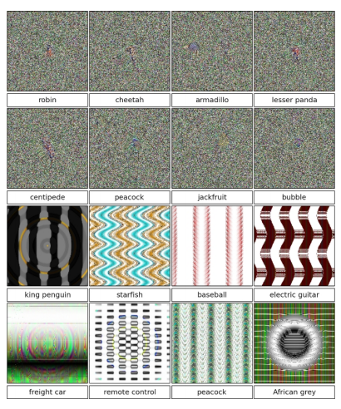
Adversarial Examples: Type 2
Meaningless patterns that are recognized as object classes with a very high confidence
Examples from [Nguyen, CVPR'14]

Slide 10
Previous Work
Generating adversarial examples
Steepest gradient descent [Szegedy, ICLR'14], gradient sign [Goodfellow, ICLR'15], universal adversarial attack [M-Dezfooli, CVPR'17], etc.
Defending adversarial examples
Distillation [Papernot, IEEE-SSP'16], large-scale learning [Kukarin, ICLR'17], ensemble [Tramer, arXiv'17], detection [Metzen, ICLR'17], randomization [Xie, arXiv’17], etc.

Slide 11
Why Adversaries Exist?
Opinion 1: deep networks are too complicated so that the high-dimensional space contains many non-linear or unexplainable structures, or they are too sensitive to small noise
Opinion 2: deep networks are still too simple to defend these malignant attacks
Opinion 3: deep networks are not the model we want!

Slide 12
Our Contribution
We extend the adversarial examples to both semantic segmentation and object detection
We are the first to achieve this goal systematically
We evaluated both white-box attack and black-box attack tasks
White-box: the network parameters are known
Black-box: the network parameters are unknown (transferring the adversarial perturbations)

Slide 13
Outline
Introduction
Adversarial Examples in Computer Vision
Dense Adversarial Generation (DAG)
Experiments: White-box Attack
Experiments: Black-box Attack
Fancy Examples
Conclusions and Future Work

Slide 14
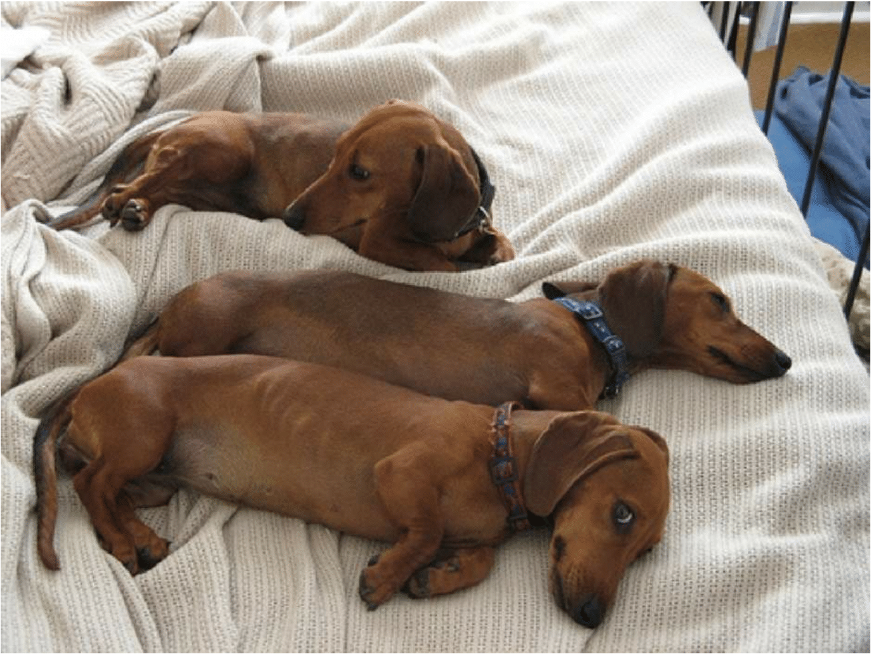
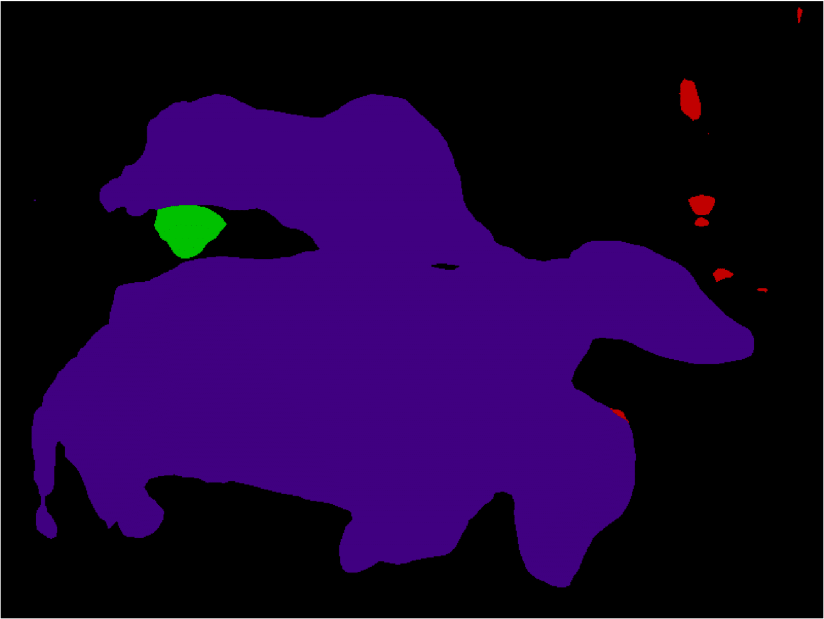
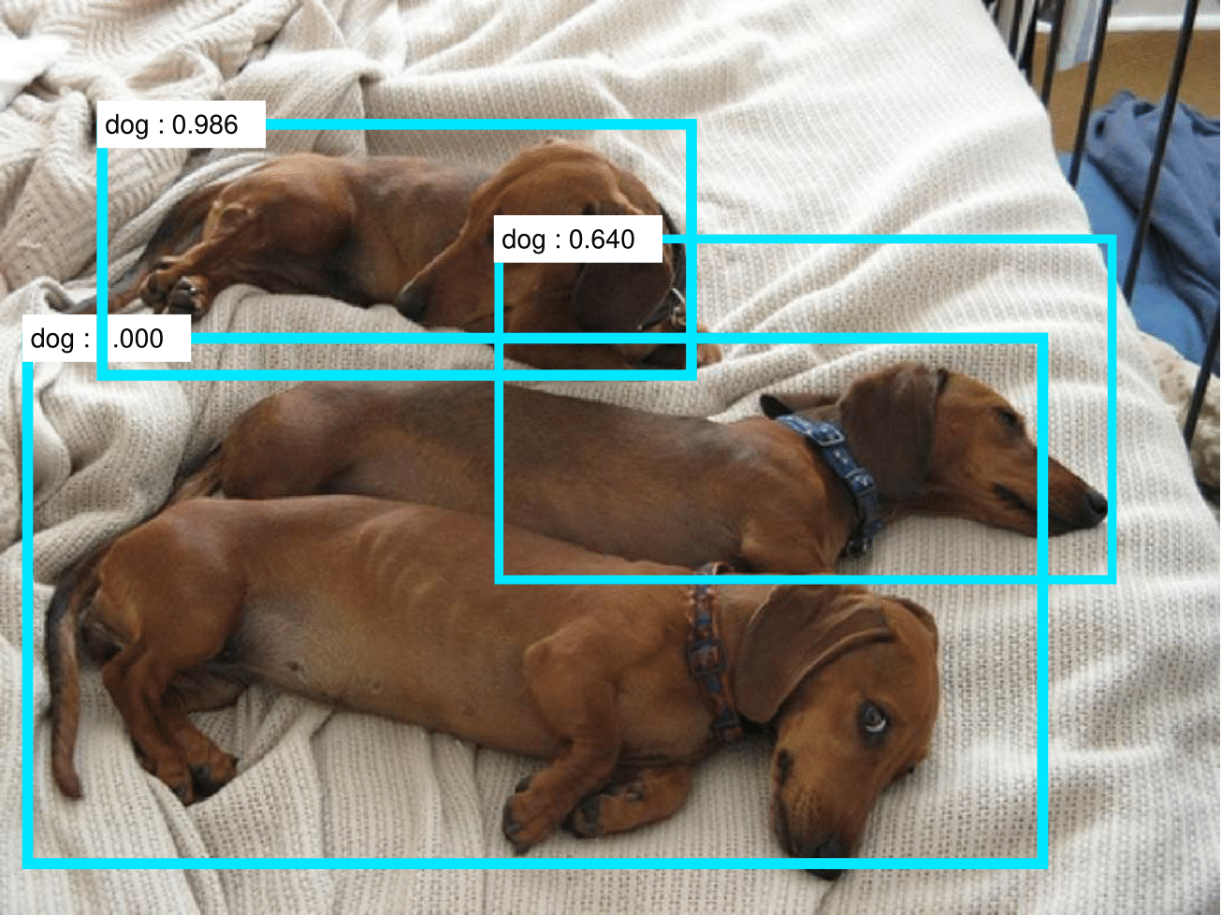
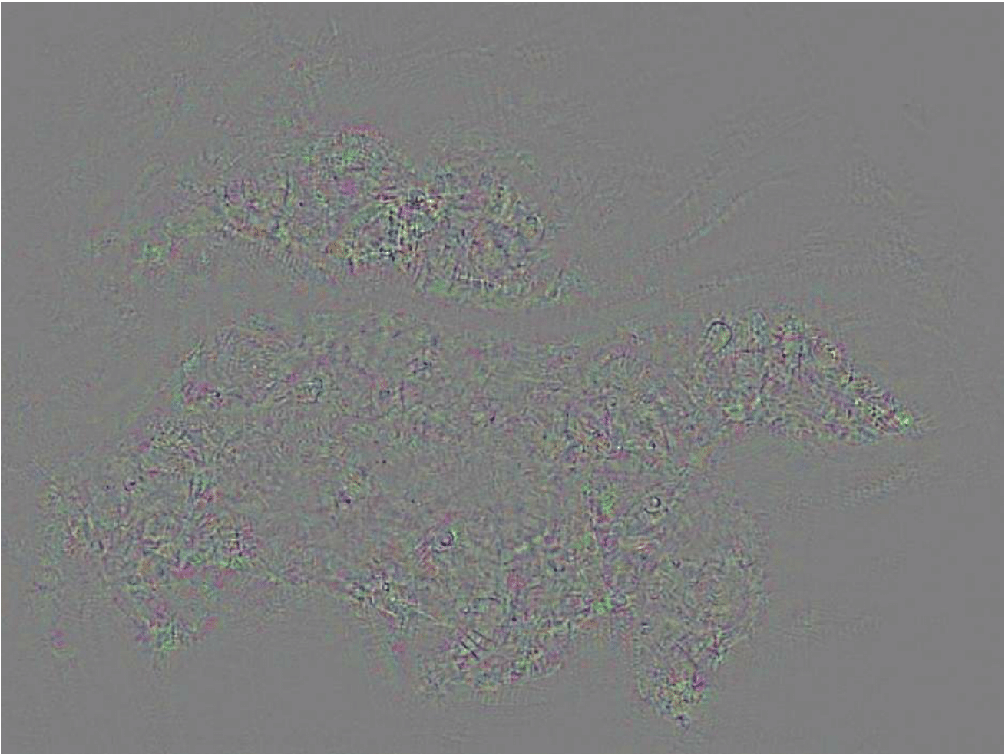
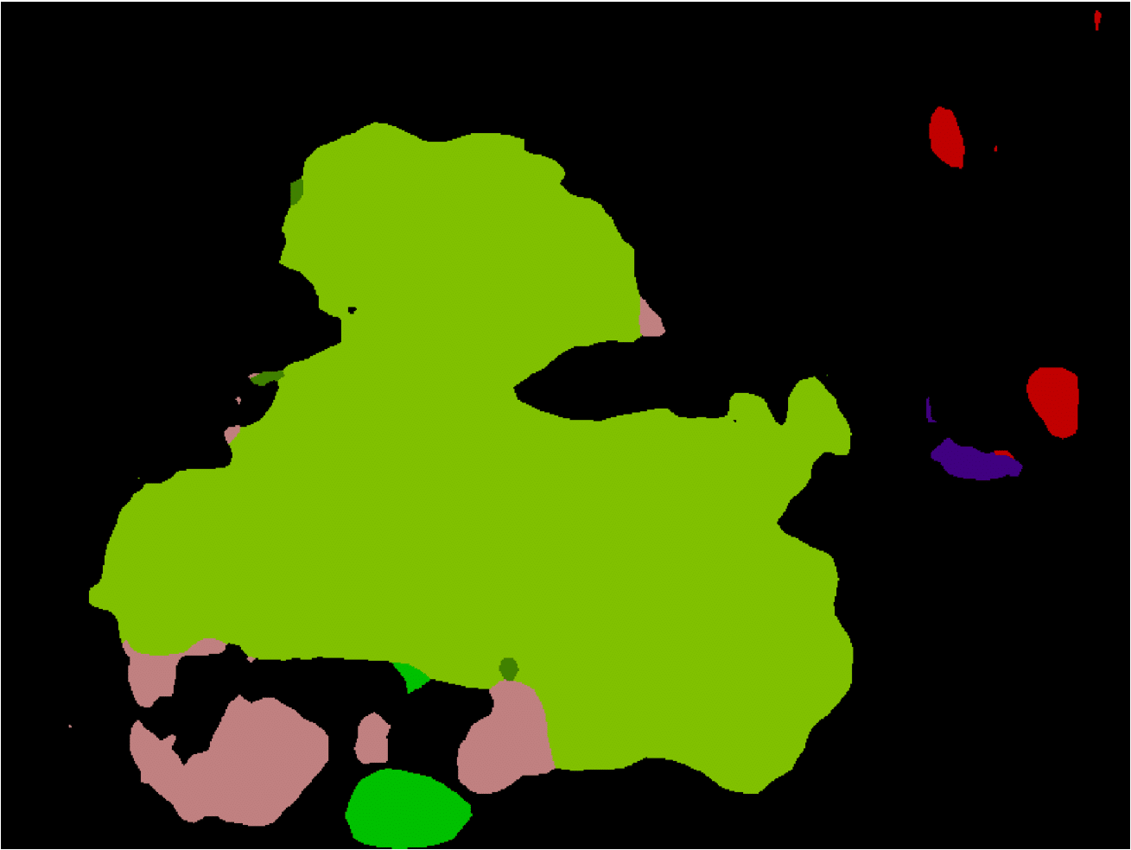
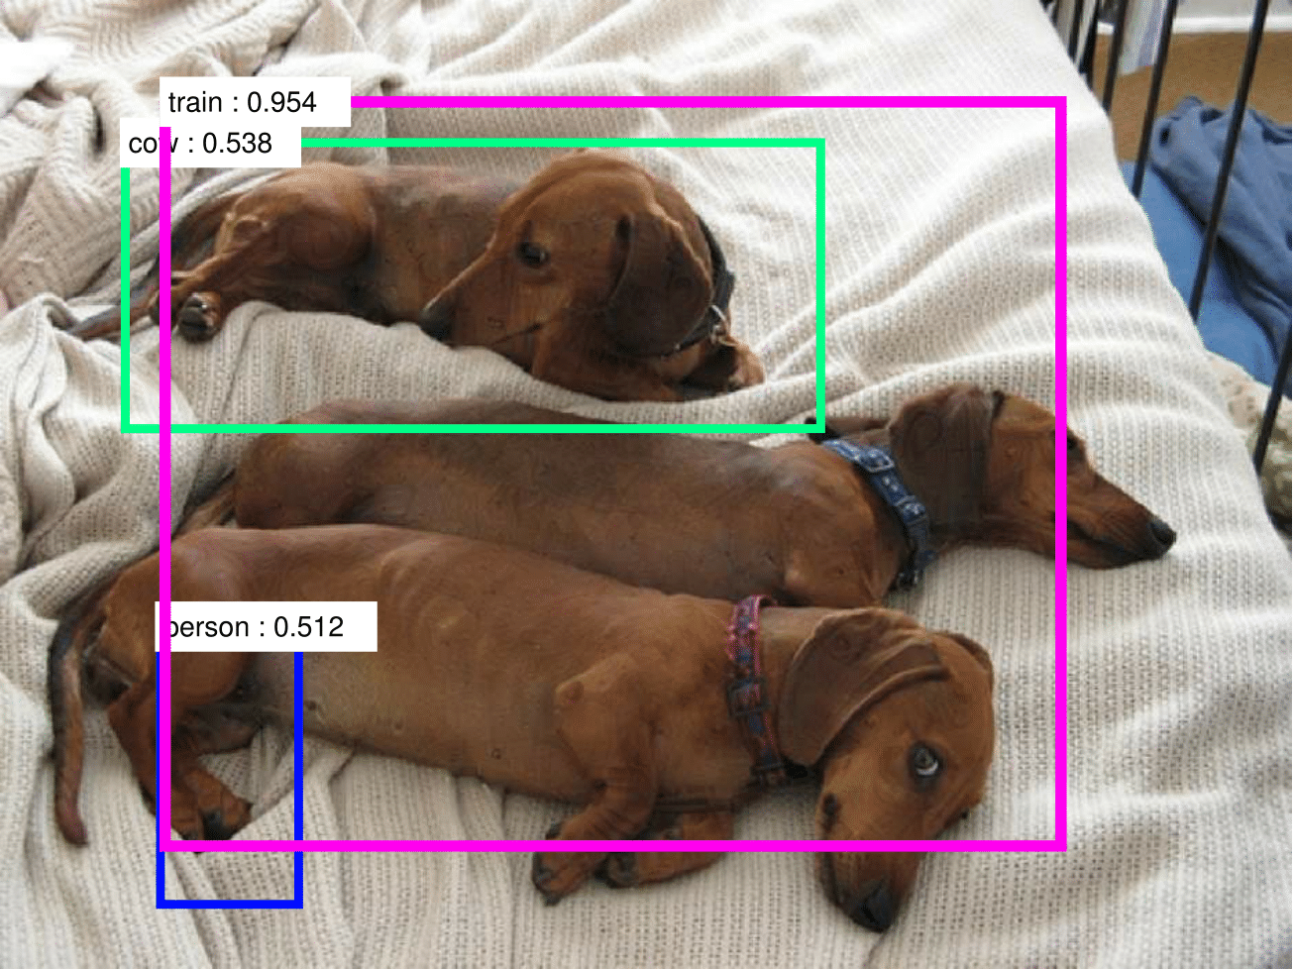
Some Typical Results
Original Image
Original Segmentation
Original Detection
Added Perturbation (10x)
Attacked Segmentation
Attacked Detection

Slide 15
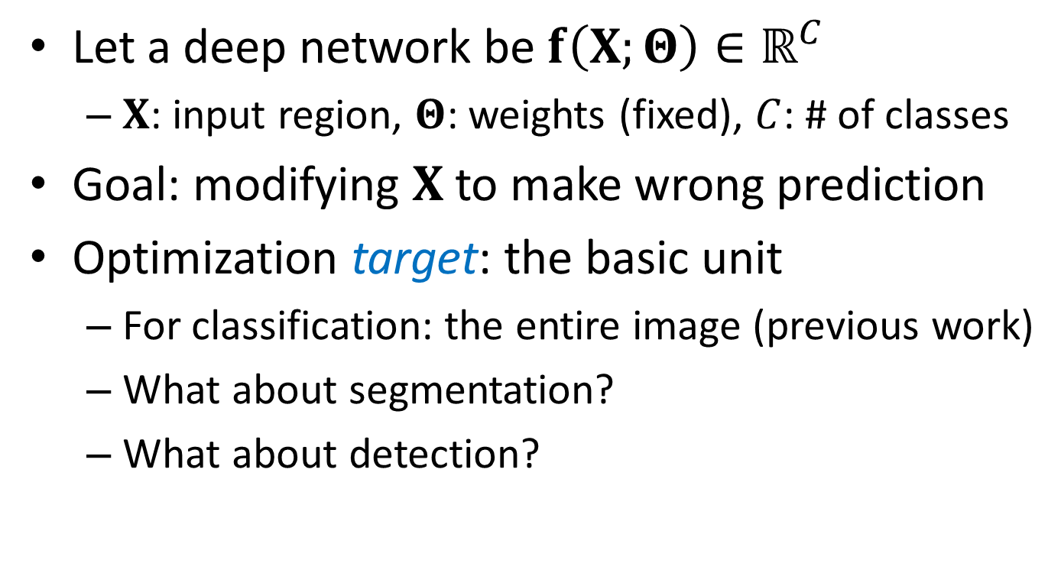
Formulation: Optimization Goal

Slide 16
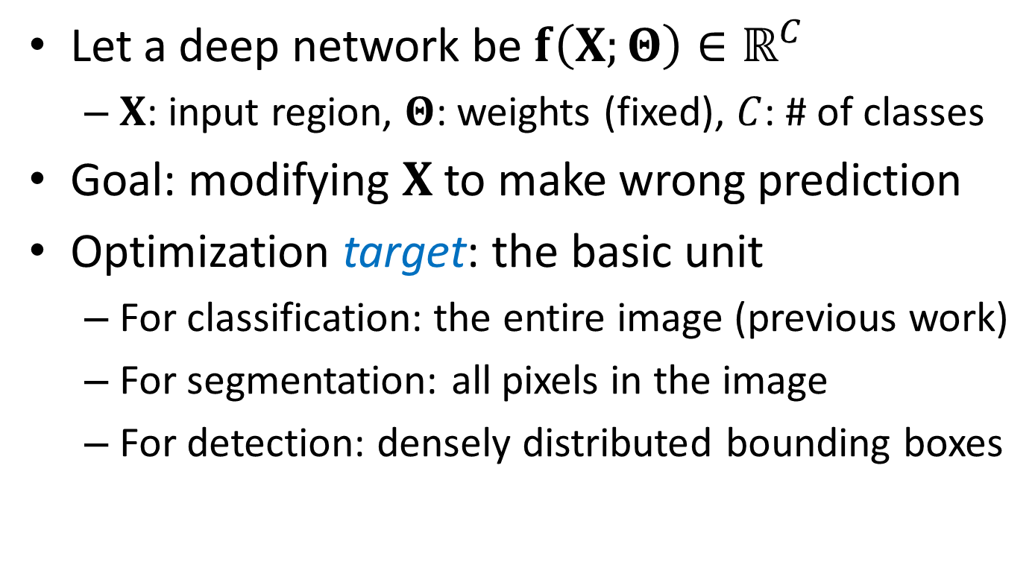
Formulation: Optimization Goal

Slide 17
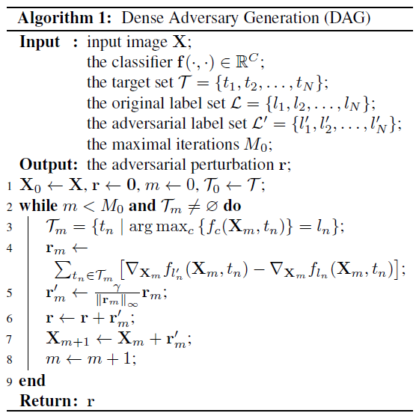
Dense Adversarial Generation
A white-box attack
Image and network dependent
Flowchart
Defining the active set
Gradient descent
Until convergence

Slide 18
Comments on Object Detection
We attacked a type of frameworks, which first extract a number of proposals, then assign a class label for each proposal
A possibility: the adversarial perturbation changes the set of proposals, and our attack will not work on the new proposals
That is why we need to generate dense bounding boxes (see the next page)

Slide 19
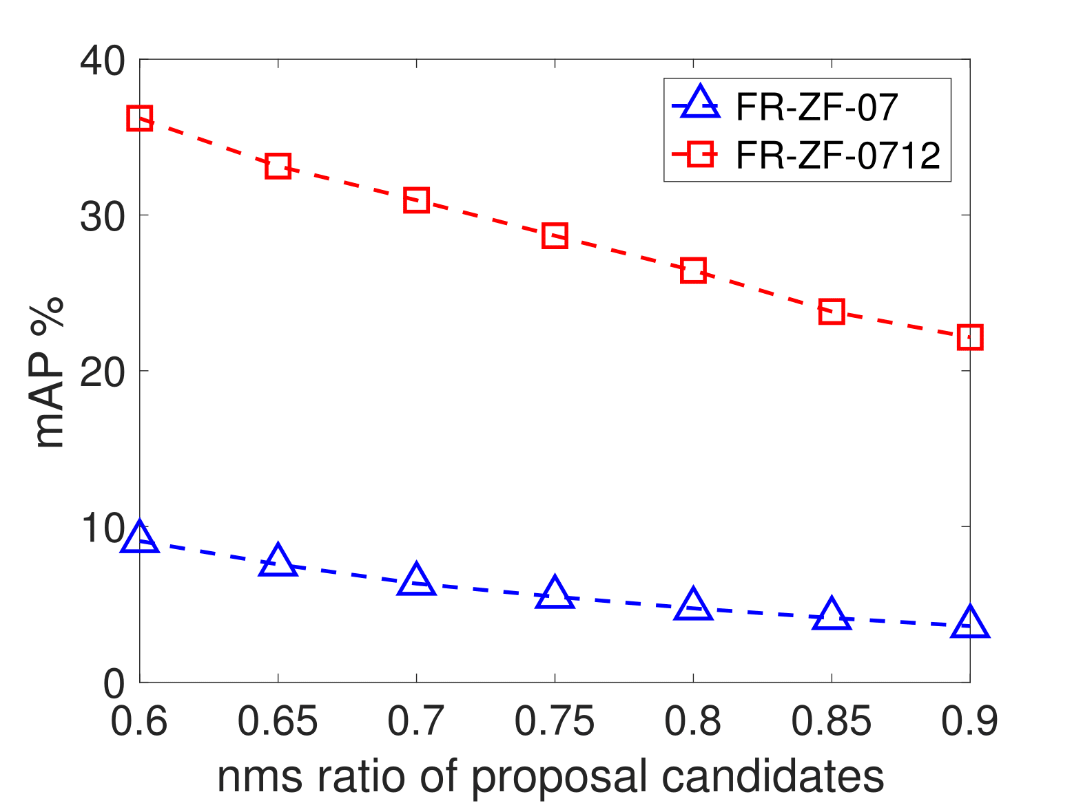
Diagnosis: Denseness
Denseness: the number of generated boxes in object detection task (the more the better)
Controlled by the non-maximum-suppression ratio

Slide 20
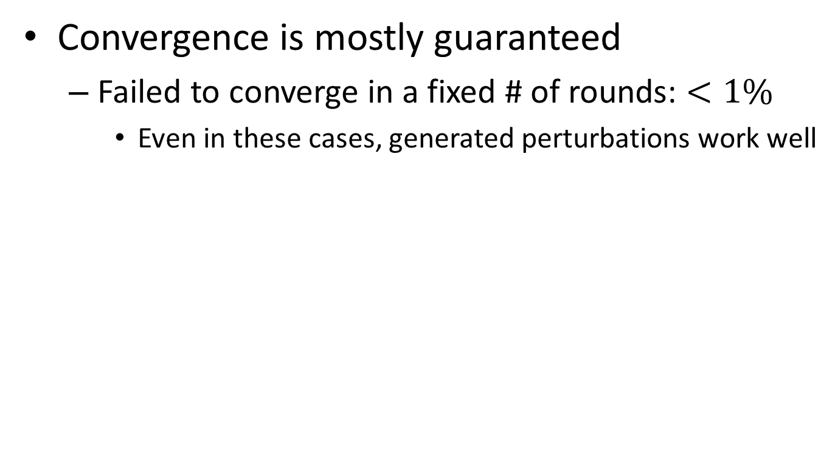
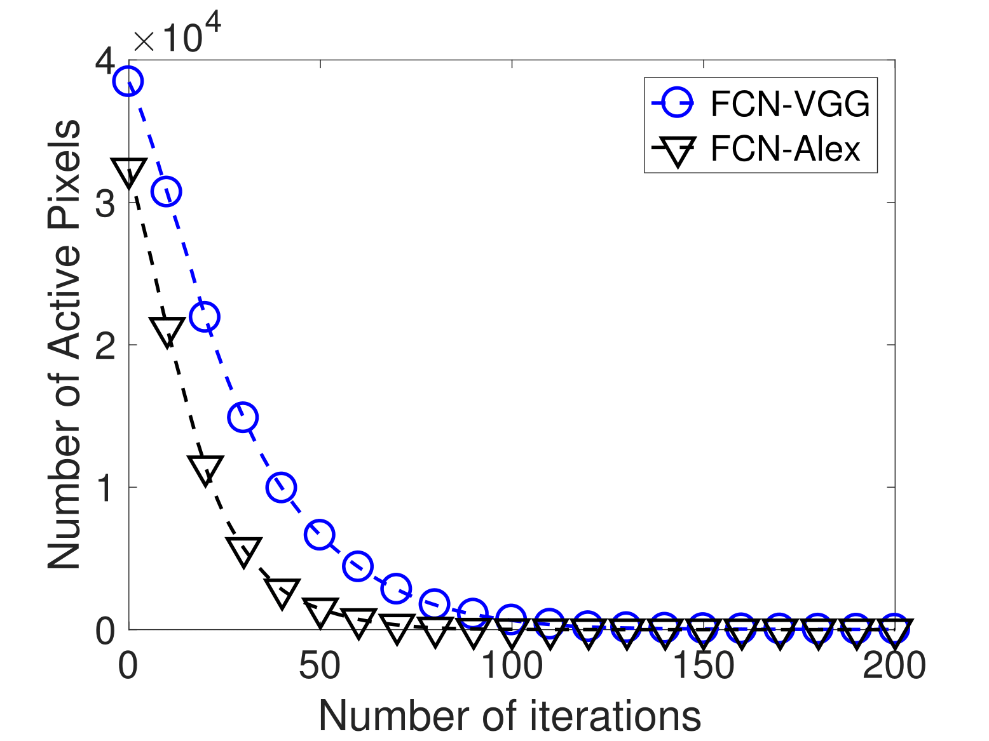
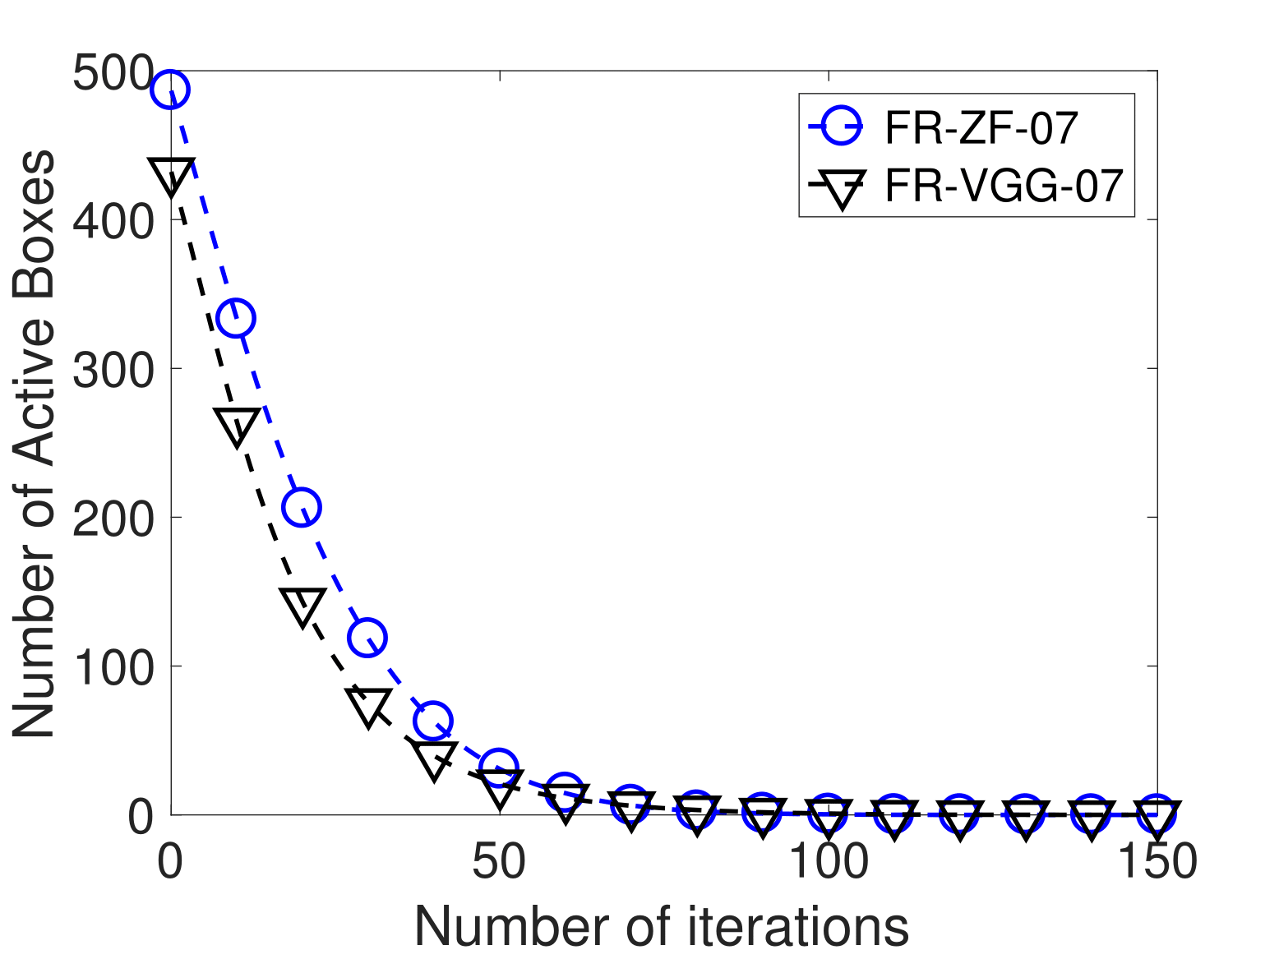
Diagnosis: Convergence

Slide 21
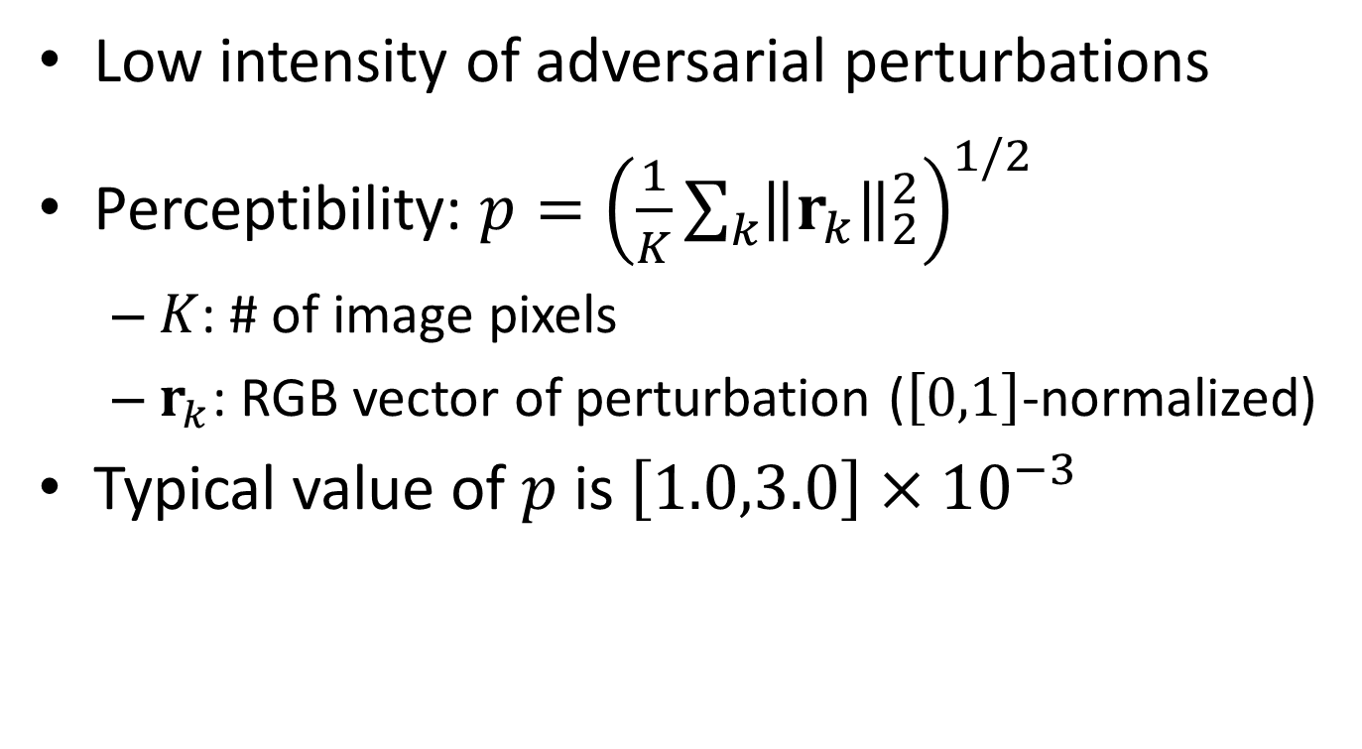
Diagnosis: Perceptibility

Slide 22
Some Typical Results
Original Image
Original Segmentation
Original Detection
Added Perturbation (10x)
Attacked Segmentation
Attacked Detection

Slide 23
Outline
Introduction
Adversarial Examples in Computer Vision
Dense Adversarial Generation (DAG)
Experiments: White-box Attack
Experiments: Black-box Attack
Fancy Examples
Conclusions and Future Work

Slide 24
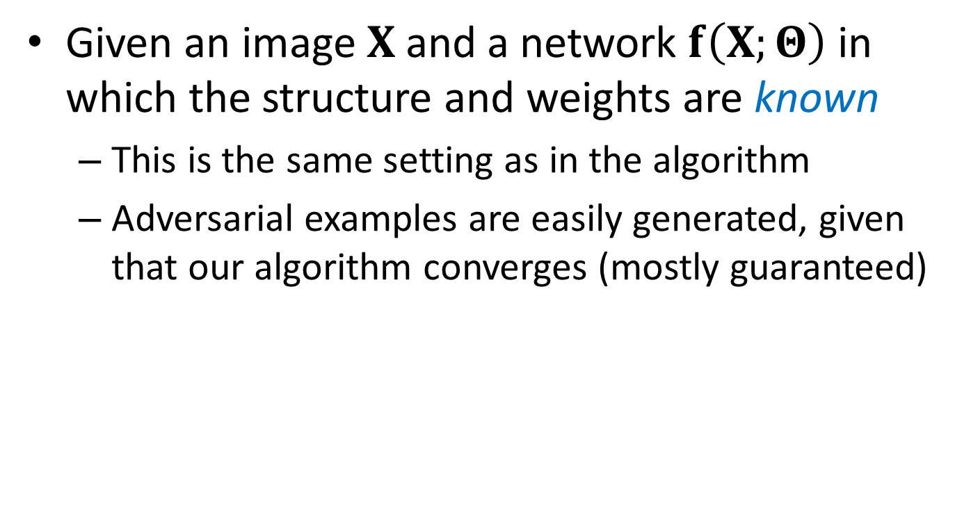
White-Box Attack: Definition

Slide 25
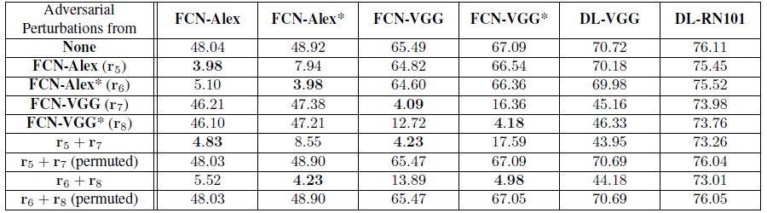
White-Box Attack: Results
Semantic segmentation part
FCN and DeepLab were evaluated
Bold numbers indicate white-box attacks

Slide 26
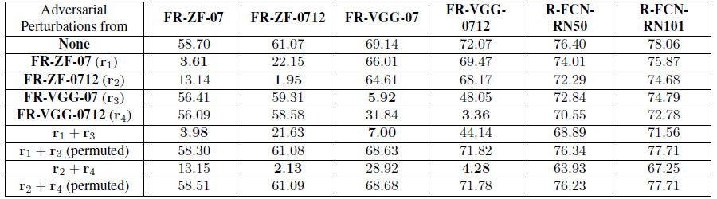
White-Box Attack: Results
Object recognition part
Faster-RCNN and R-FCN were evaluated
Bold numbers indicate white-box attacks

Slide 27
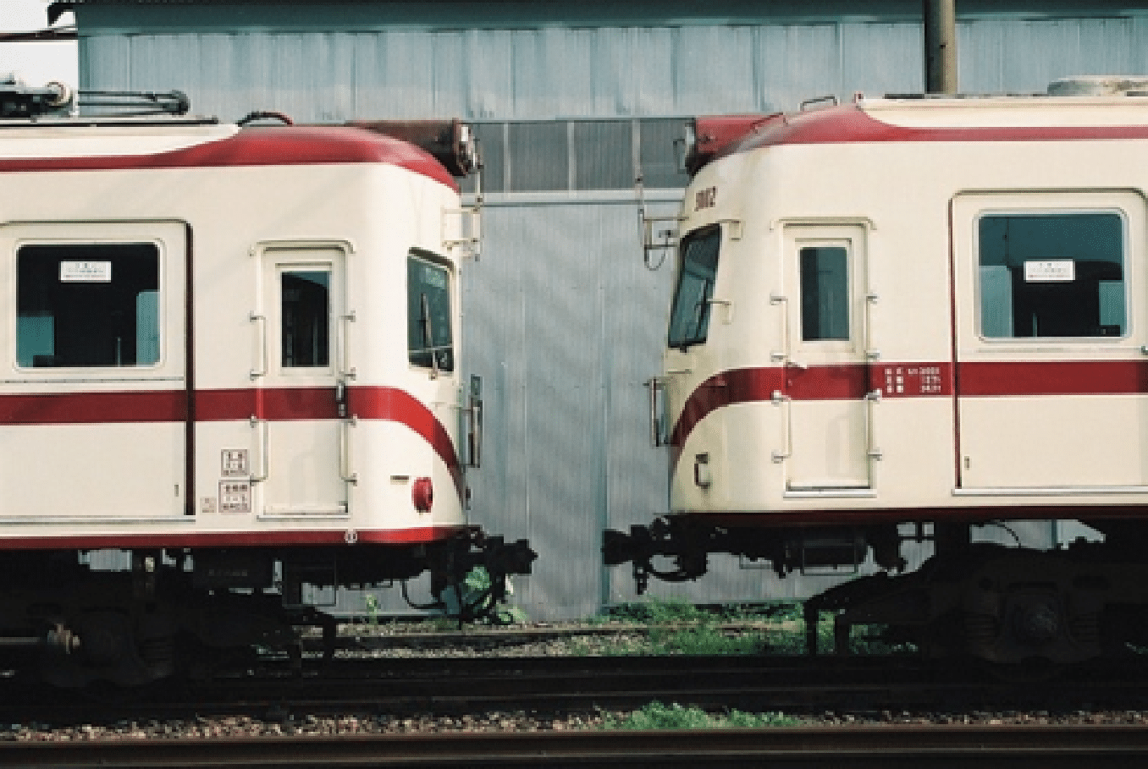





White-Box Attack: Examples
Original Image
Added Perturbation (10x)
Attacked Segmentation
Original Image
Added Perturbation (10x)
Attacked Segmentation

Slide 28
Outline
Introduction
Adversarial Examples in Computer Vision
Dense Adversarial Generation (DAG)
Experiments: White-box Attack
Experiments: Black-box Attack
Fancy Examples
Conclusions and Future Work

Slide 29
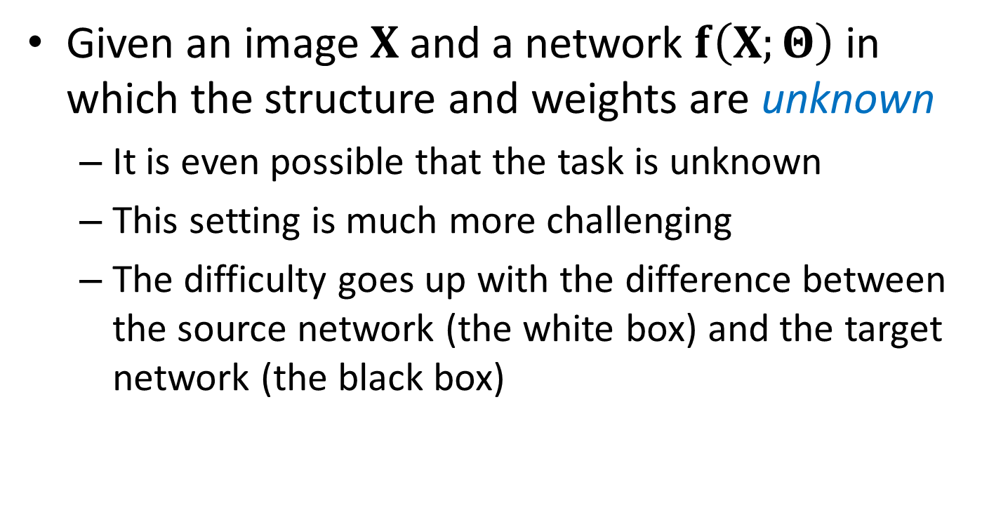
Black-Box Attack: Definition

Slide 30
Black-Box Attack: Results
Semantic segmentation part
Transfer across different training sets
Transfer across different networks

Slide 31
Black-Box Attack: Results
Object recognition part
Transfer across different training sets
Transfer across different networks

Slide 32
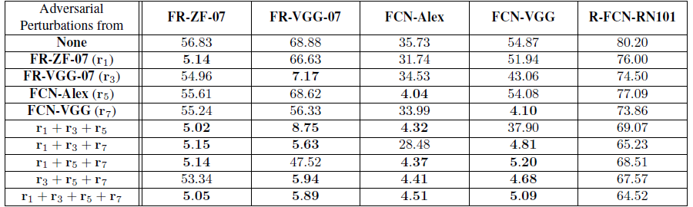
Black-Box Attack: Results
Transfer across different tasks
This is the most challenging task investigated
Ensemble is the only way of enhancing attack

Slide 33
Black-Box Attack: Facts
Black-box attack is much more difficult
The difficulty goes up with the difference between the source and target networks
"Difficulty levels" in transfer
Level 1: across different datasets
Level 2: across different network structures
Shallower networks are not easier to attack
Level 3: across different vision tasks
Same network structure makes things easier

Slide 34
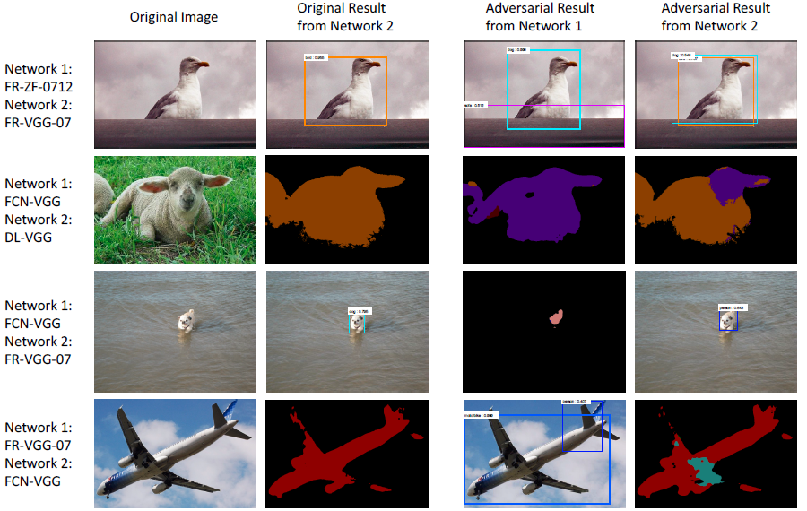
Black-Box Attack: Examples

Slide 35
Outline
Introduction
Adversarial Examples in Computer Vision
Dense Adversarial Generation (DAG)
Experiments: White-box Attack
Experiments: Black-box Attack
Fancy Examples
Conclusions and Future Work

Slide 36
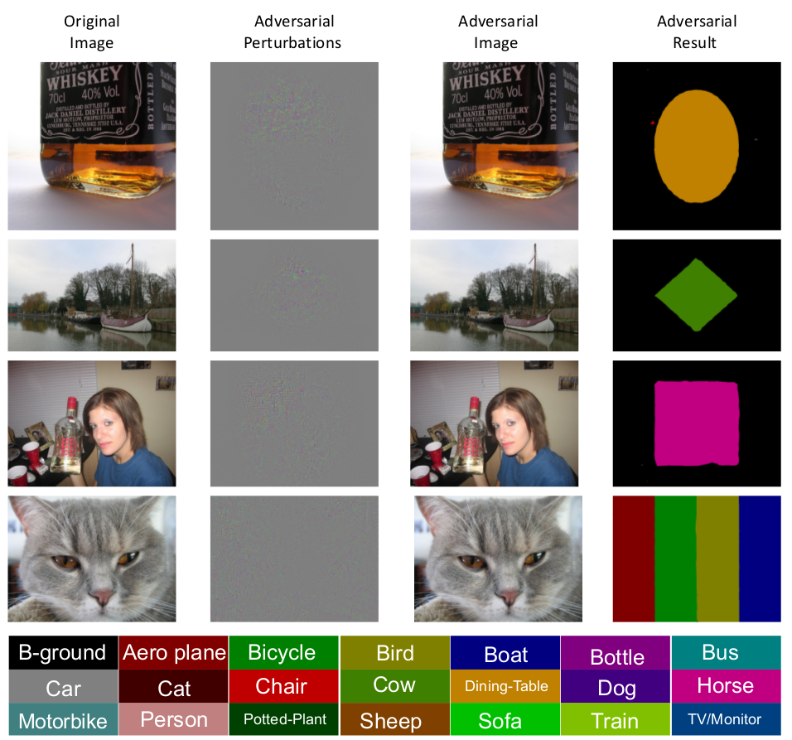
Different Geometric Patterns

Slide 37
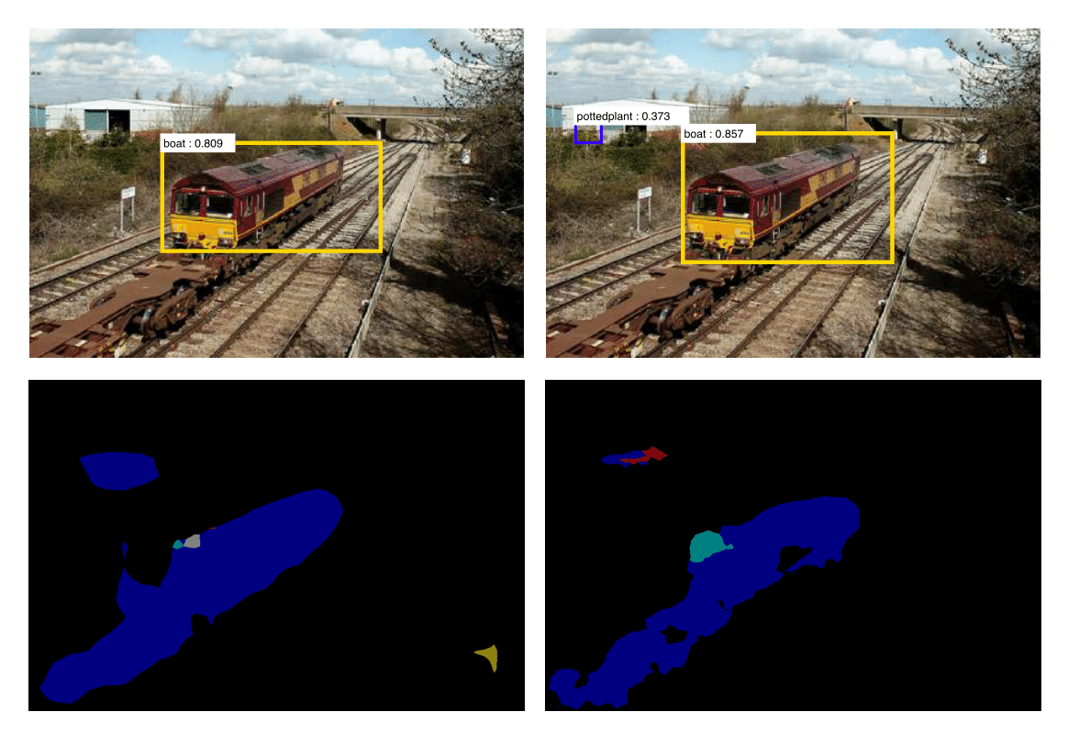
An adversarial example for both detection and segmentation
The top row shows FR-VGG-07 and FR-ZF-07 detection results, and the bottom row shows FCN-Alex and FCN-VGG segmentation results. The blue in segmentation results corresponds to boat.

Slide 38
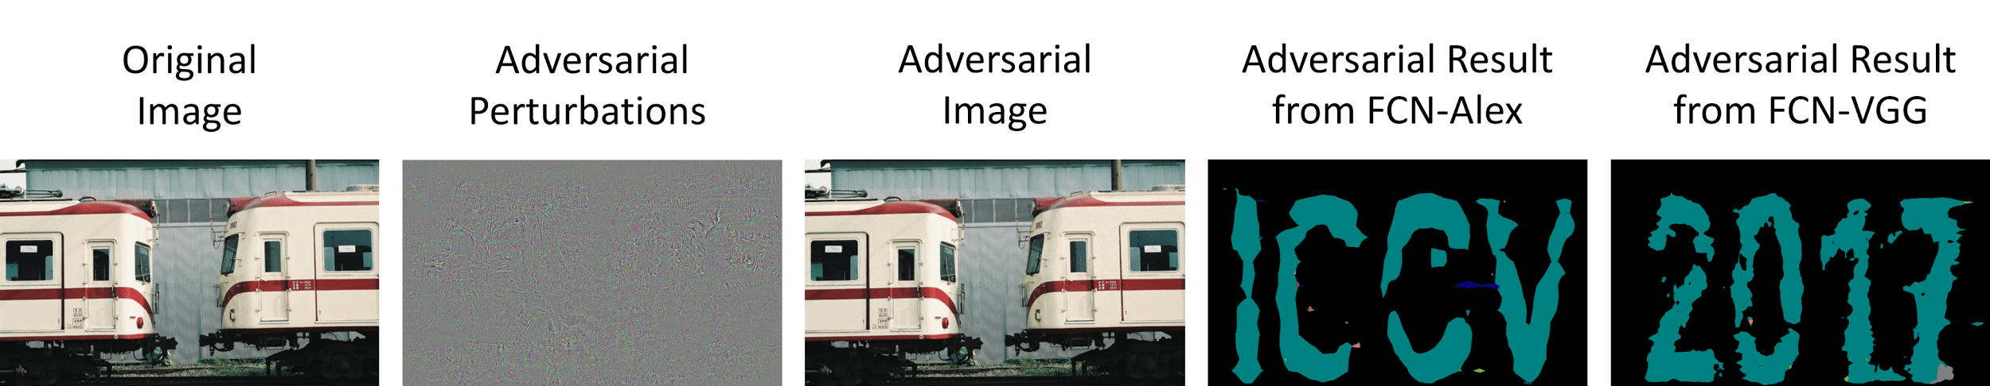
Same adversarial example, Completely different Outputs
We add one adversarial perturbation (magnified by 10) to the same original image to generate different pre-specified segmentation masks on two deep segmentation networks (FCN-Alex and FCN-VGG). This is a more difficult task compared to that shown in previous figure, where two different adversarial perturbations are used to generate two pre-specified segmentation masks. The blue regions in the segmentation masks are predicted as bus, a randomly selected class.

Slide 39
Outline
Introduction
Adversarial Examples in Computer Vision
Dense Adversarial Generation (DAG)
Experiments: White-box Attack
Experiments: Black-box Attack
Fancy Examples
Conclusions and Future Work

Slide 40
Conclusions
Adversarial examples exist in both semantic segmentation and object detection
A simple algorithm based on gradient descent
The target can be arbitrary to some extents
White-box attack: efficient and effective
Black-box attack: a more challenging problem
Transfer across datasets, networks and tasks
Ensemble is an effective solution

Slide 41
Future Work
Defending adversarial attacks
Attack vs. defense: which one is stronger?
Finding out the reason of adversarial examples in the context of deep neural networks
Integrating adversarial examples in training deep neural networks

Slide 42
Thank you!
Questions please?

